Slide 1
IT2757 Server and Services Security Management

Slide 2
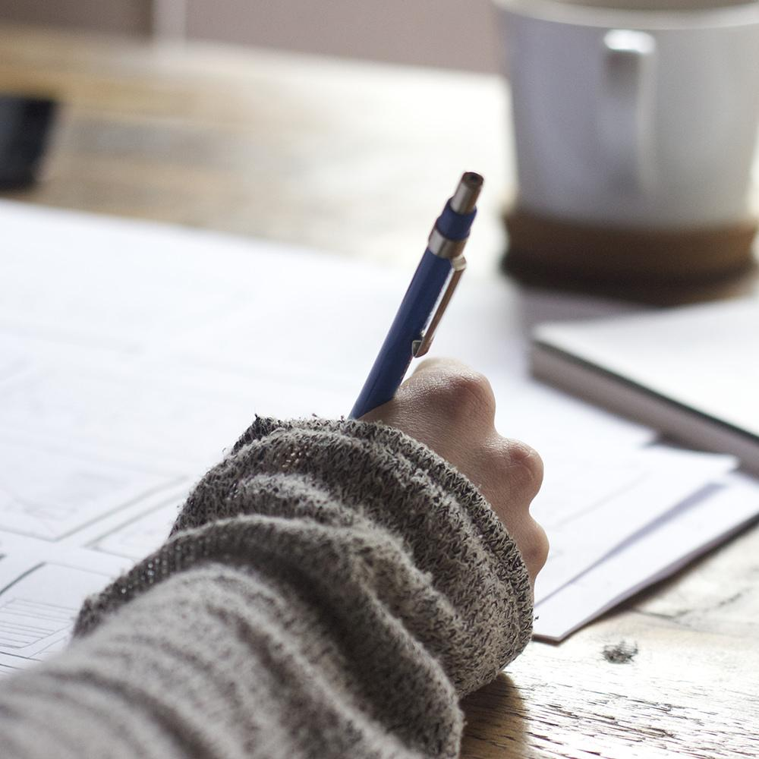
Hello!
I am Mr. Simon LAM
You can find me at simon_lam@nyp.edu.sg
Tel: 6550-1751

Slide 3
Introduction to the course
Refer to Blackboard

Slide 4
What is a Server
2

Slide 5
VOLUNTEERS PLEASE …

Slide 6
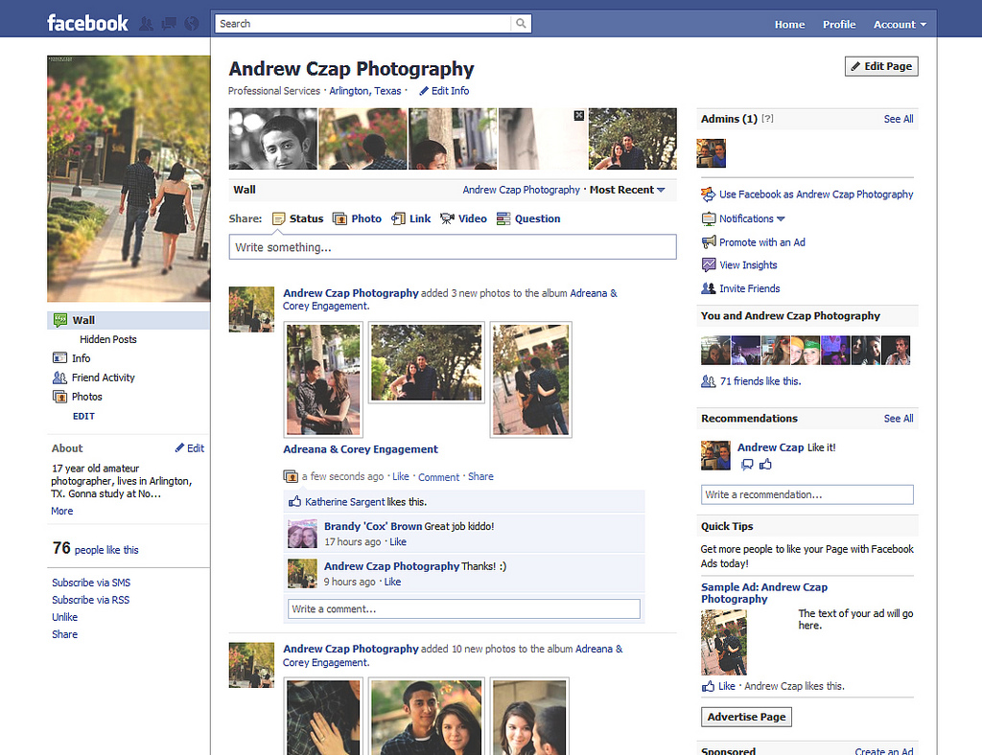
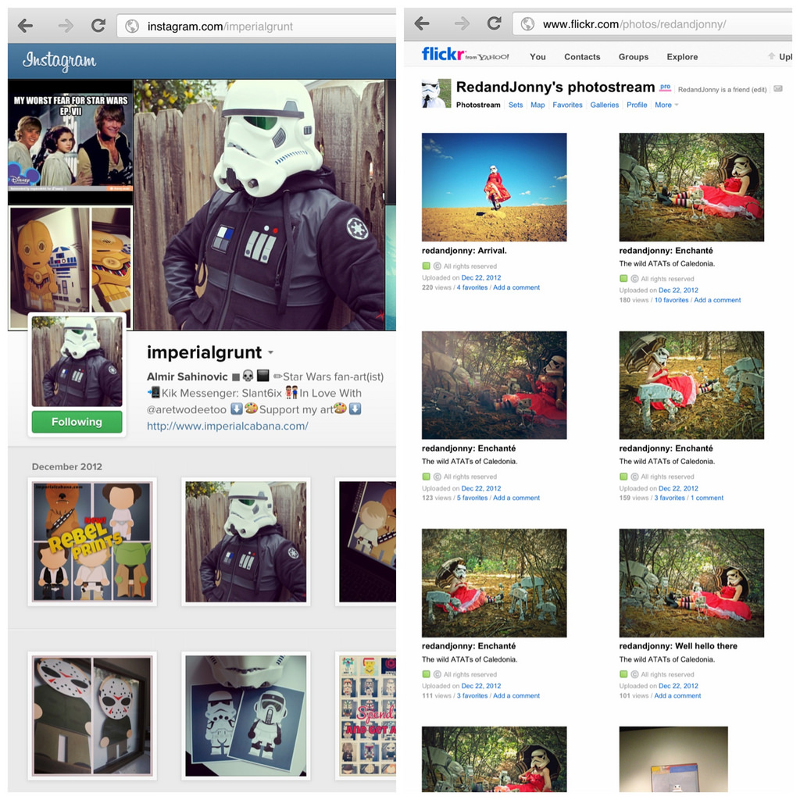

Slide 7
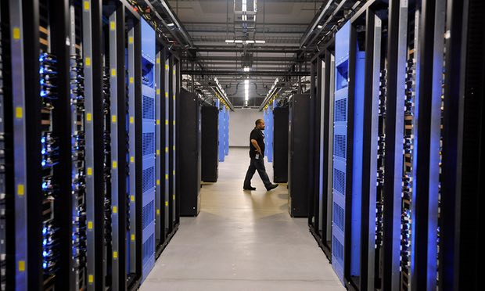
Facebook Data Centre
What is behind Facebook..
Where and how does it store your messages, videos and images

Slide 8
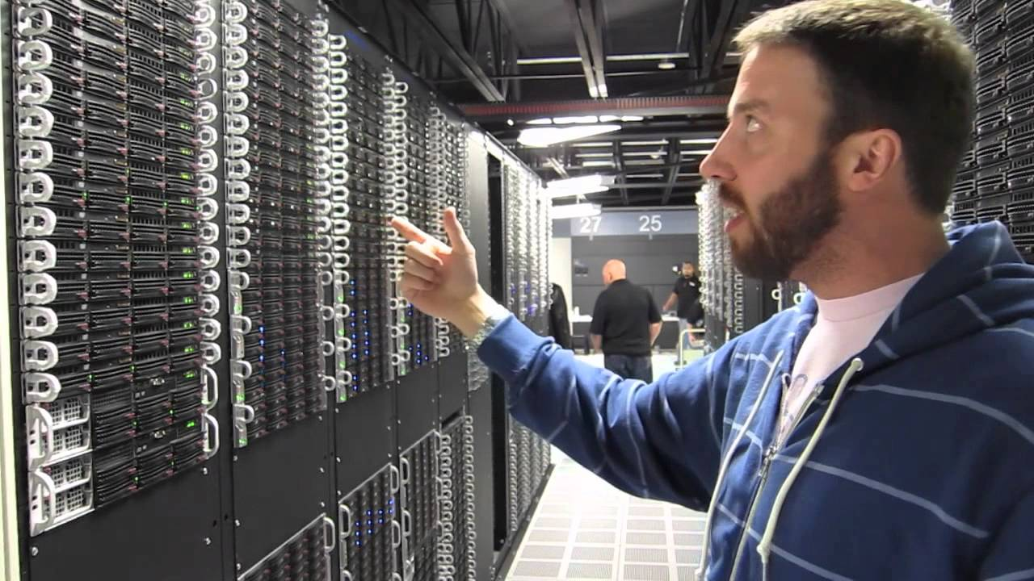

Slide 9
360,000 servers
500+ terabytes per day
100% up and running
That’s a lot of servers
And a lot of users
Uptime

Slide 10
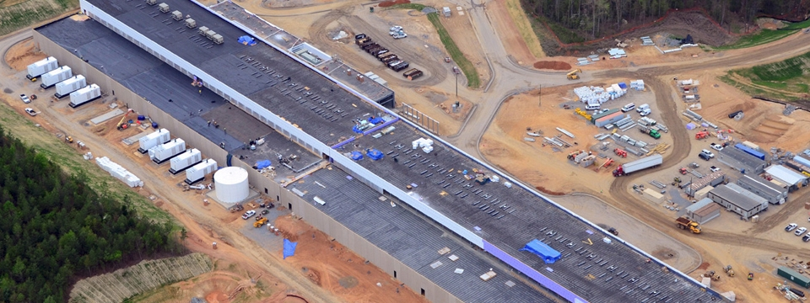
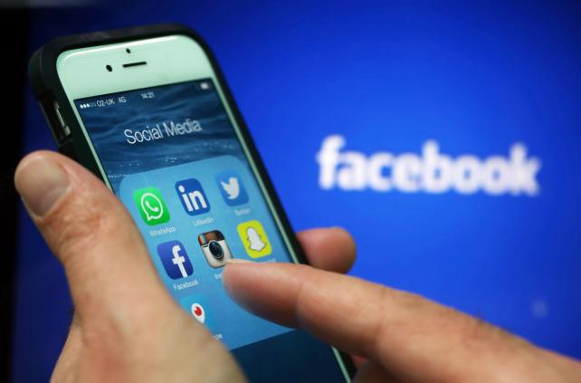
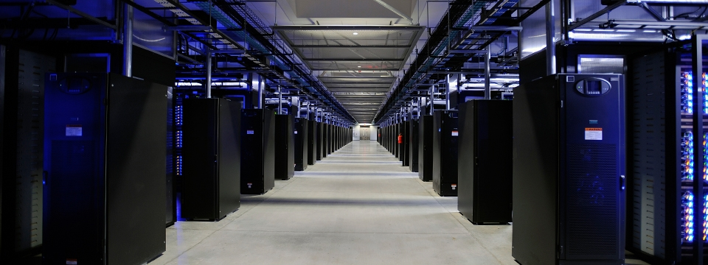

Slide 11
Server Hardware
3

Slide 12
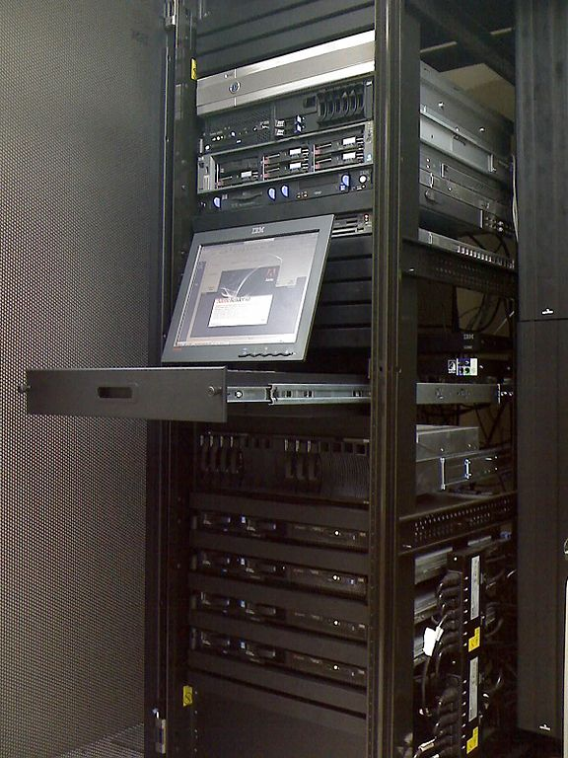
Server Hardware
Similar as personal computer, it has CPU, motherboard, memory, hard disk, network interface card, I/O devices, etc.
Unlike personal computers, normally monitor is not required.

Slide 13
Server Hardware
A server is a system (software and suitable computer hardware) that responds to requests across a computer network to provide, or help to provide, a network service.

Slide 14
CHARACTERISTICS OF A SERVER HARDWARE
High reliability and durability.
eg. ECC memory, redundant disk
Fast network connection.
eg. Gbit Ethernet or even Optical Fiber connection
Fast I/O throughput
eg. Fast hard disk with Raid (redundant array of independent disks)
Low power consumption

Slide 15
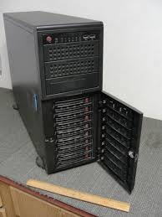
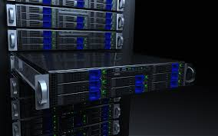
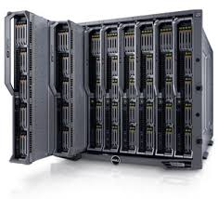
Server Hardware
Standalone
Rack Server
Blade Server

Slide 16
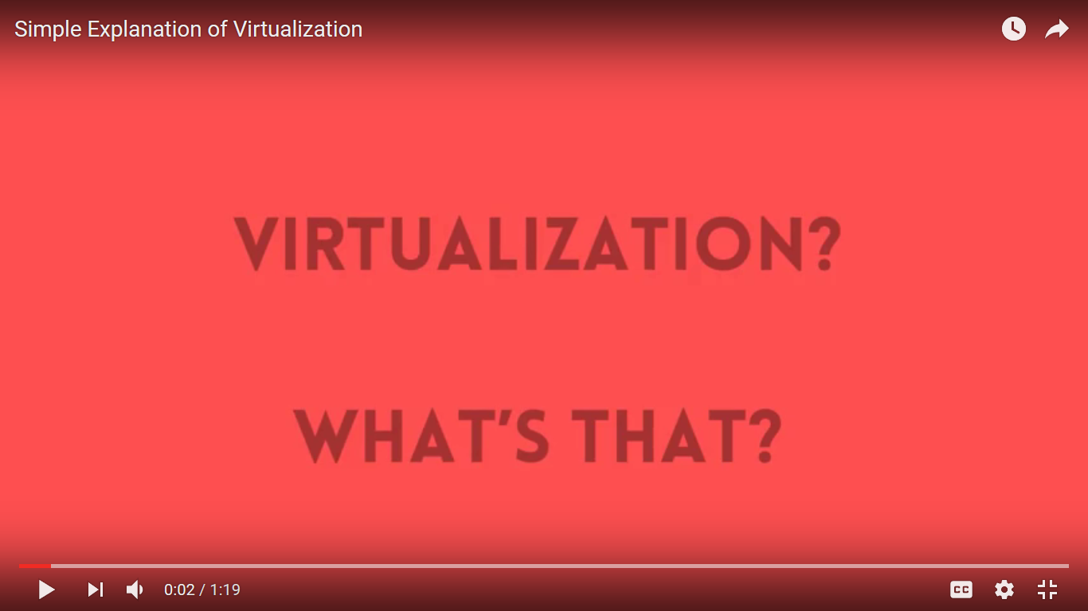
Server Hardware - Virtual Server

Slide 17
Server Hardware - Hyperconverged

Slide 18
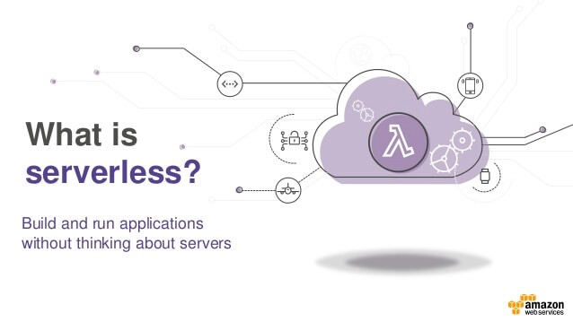
SERVERLESS COMPUTING

Slide 19
Server Operating Systems
4
Let’s start with the first set of slides

Slide 20
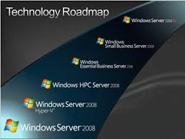
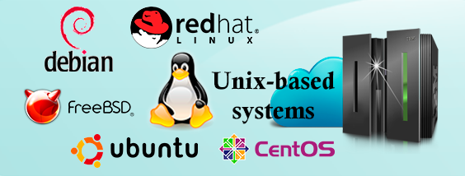
Server Operating Systems
Windows
Unix/Linux

Slide 21
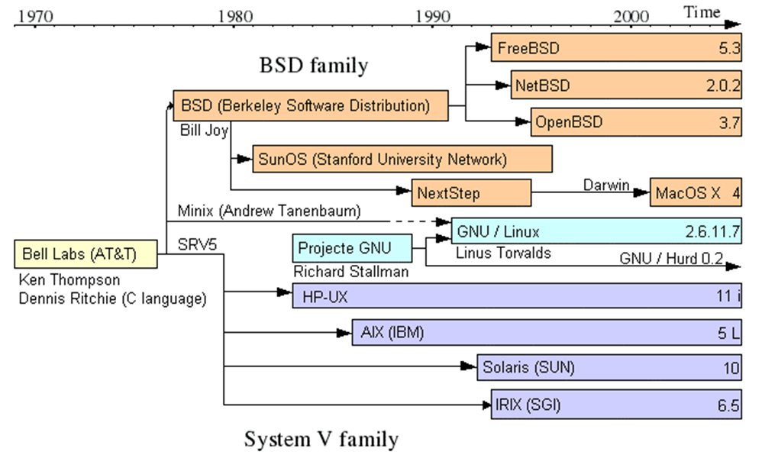
Unix-based OS

Slide 22
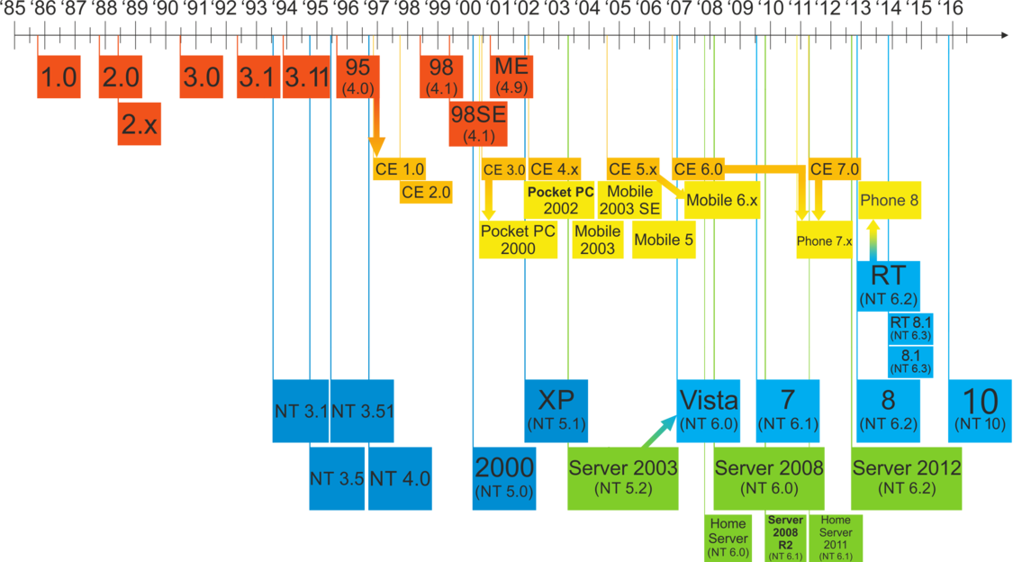
Windows OS

Slide 23
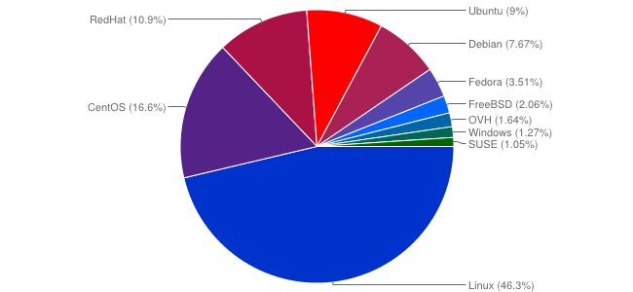
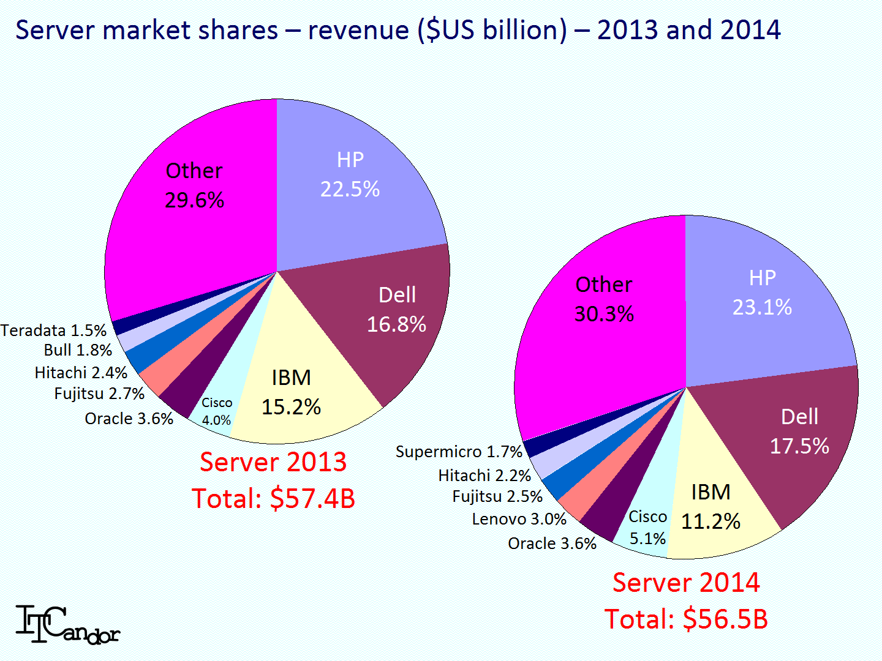
Server OS
Server Market Share by Vendor

Slide 24
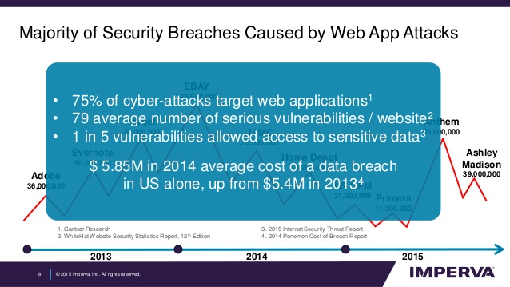
WHY THIS TOPIC..

Slide 25
THE END

